Slide 1

PISO SHIFT REGISTER IMPLEMETATION USING FSM
Analog and Digital Testing, Debug and Diagnosis
UE21EC343BB4
Team Members:
Chandana MU - PES1UG21EC074
Dhanush D - PES1UG21EC082
Disha Rajgopal - PES1UG21EC090
Guide: Dr. K Sudheendra Kumar

Slide 2
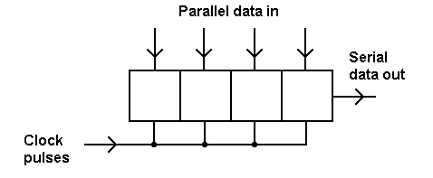
What is PISO Shift Register?
A PISO shift register is a digital circuit that takes multiple parallel data as input and converts it into a single serial data for output, making it a valuable component in digital design and communication systems.
PISO shift registers are often used to reduce the number of output pins required to transmit parallel data.

Slide 3
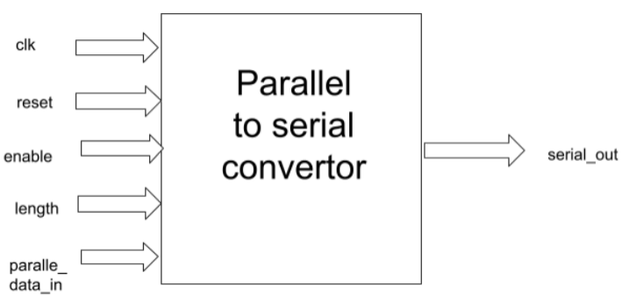
Design-Model
clk - System Clock
reset - System Reset
enable - initializes the parallel to serial conversion functionality within the converter block
length - Conveys the length of the input parallel data to be serialized
parallel_data_in - Data input meant to be serialized;
serial_out - Serialized output

Slide 4
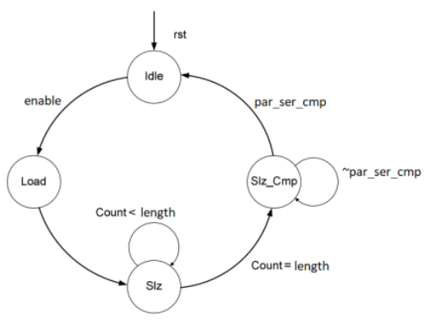
FSM-Model
● Idle: Waits for the enable signal; When the enable signal is on, the state transitions from idle state to load state.
● Load: The input parallel data is loaded into a *register.
● Slz: The process of serialization takes place i.e., the MSB of the data in the *register is popped out and the data is left shifted. This process continues until the ‘count’ is less than the length of the input data - ‘length’.
● Slz_Cmp: Once the serialization process is complete, the signal - ‘par_ser_cmp’ is asserted high.
● par_ser_cmp - the signal is high when the serialization of a parallel data is completed.(intermediate signal for fsm)

Slide 5
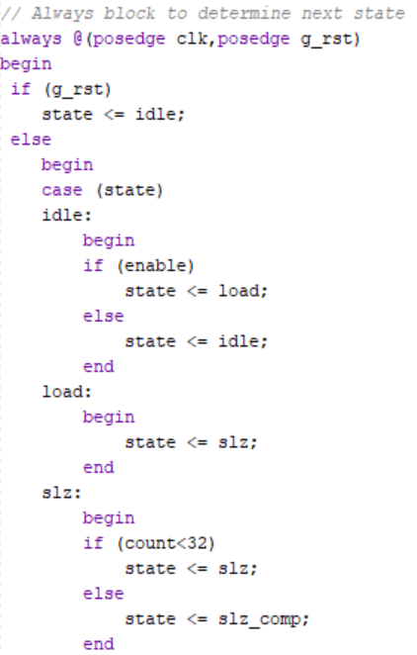
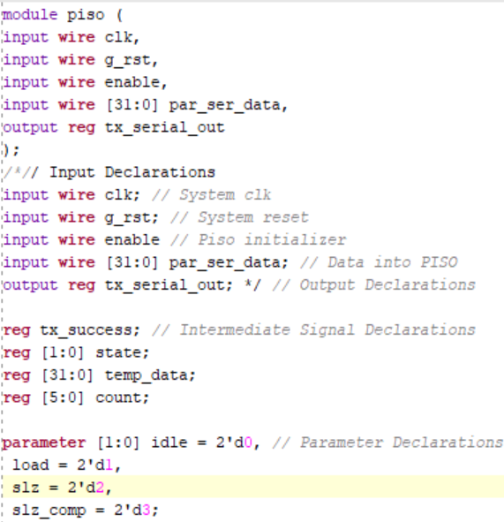
Design Code

Slide 6
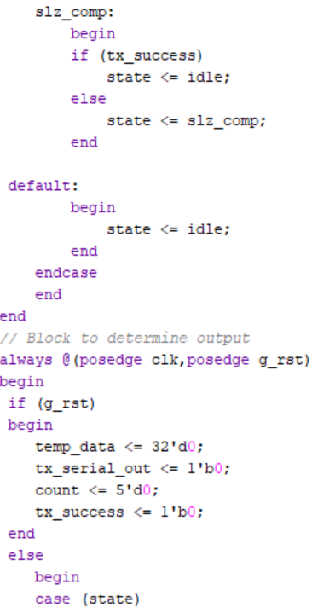
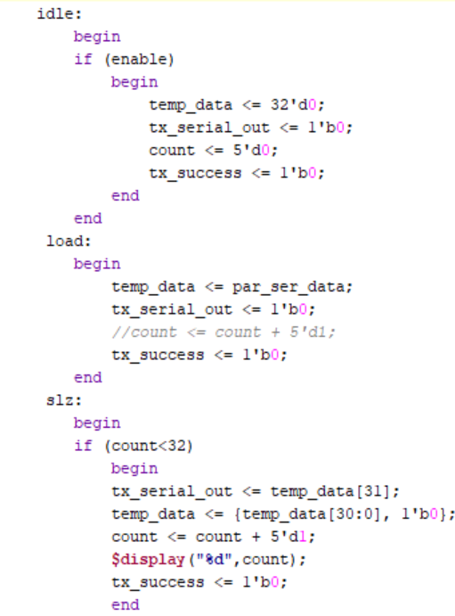
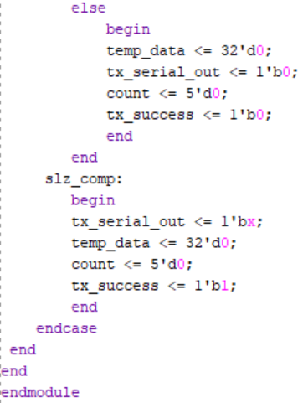

Slide 7
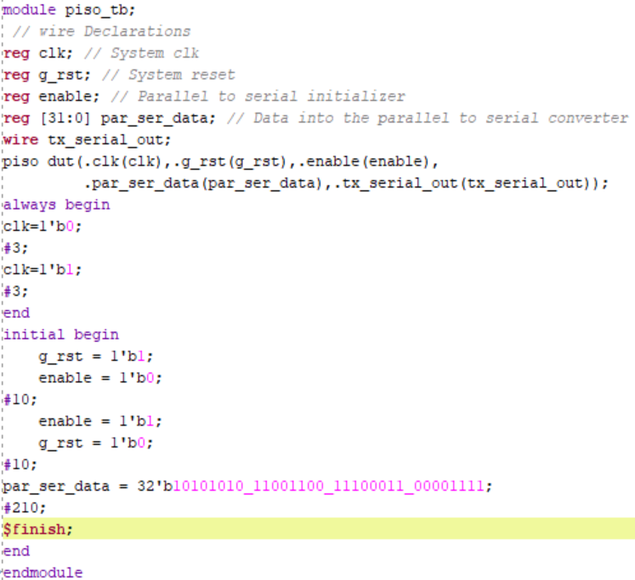
Test Bench
Code

Slide 8
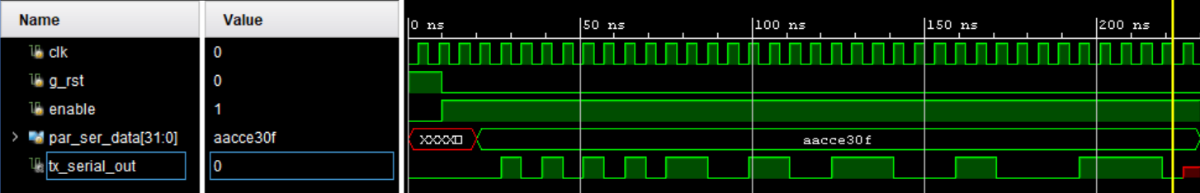
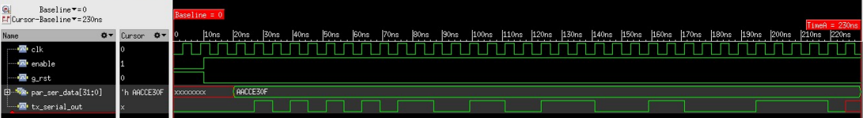
Output Waveform

Slide 9
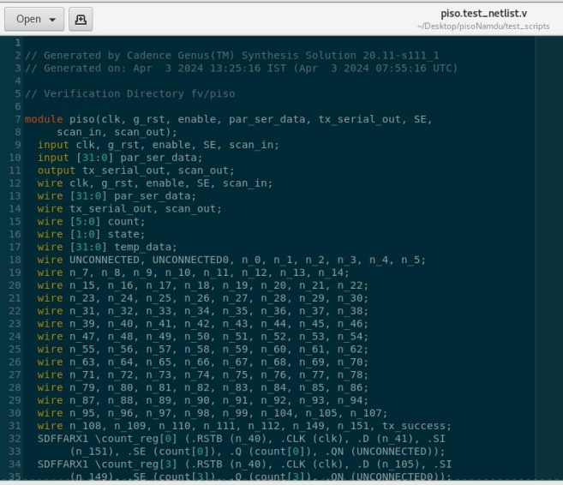
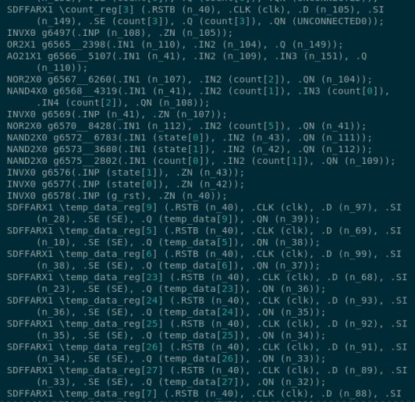
Netlist file after inserting test logic

Slide 10
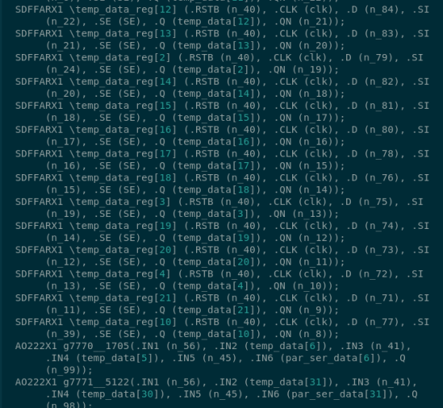
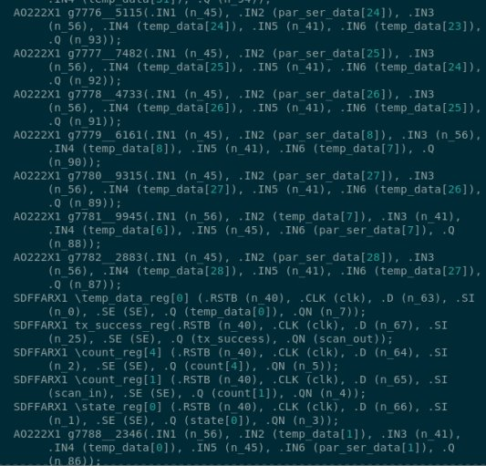

Slide 11
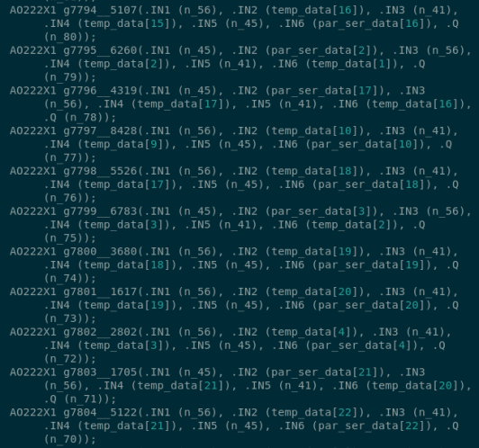
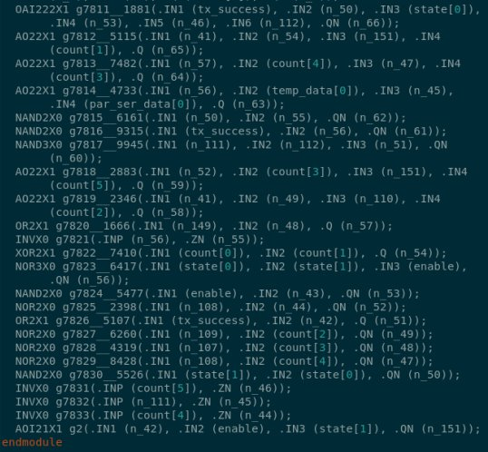

Slide 12
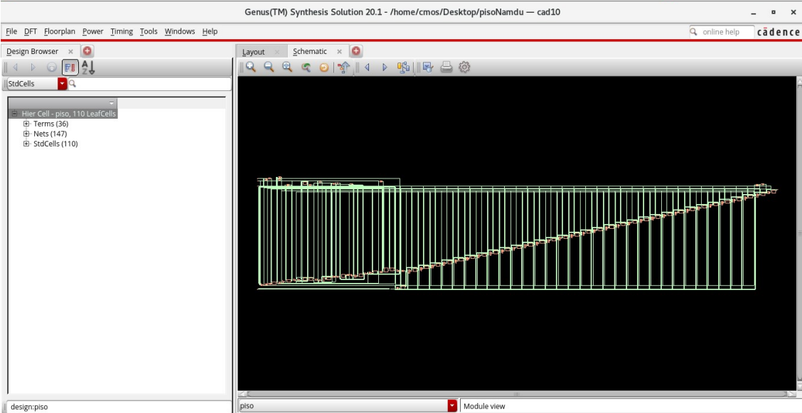
Netlist without Test logic- GUI screenshot

Slide 13
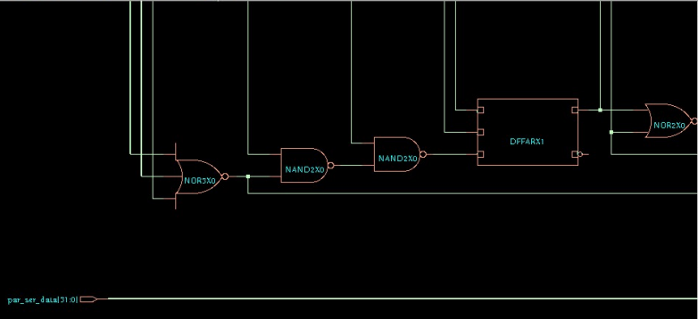

Slide 14
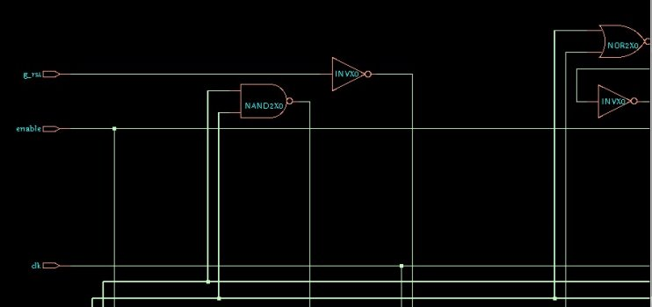

Slide 15
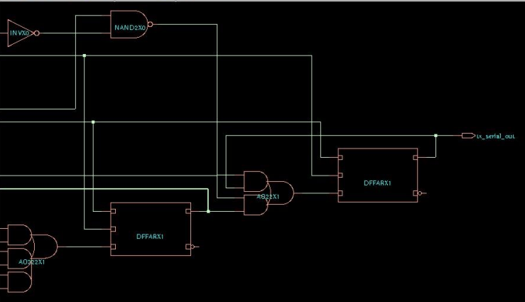

Slide 16
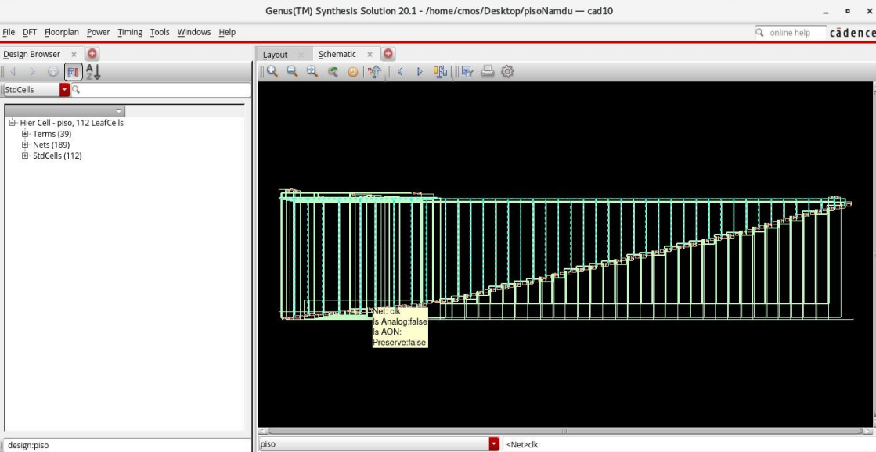
Netlist after inserting test-GUI screenshot

Slide 17
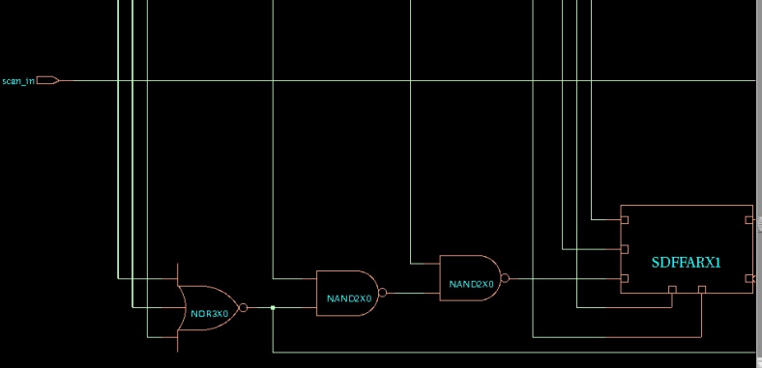

Slide 18
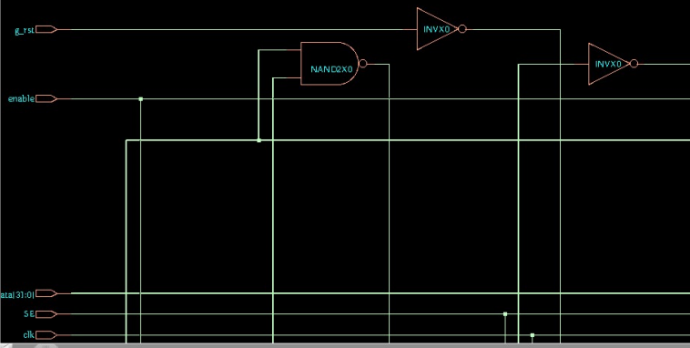
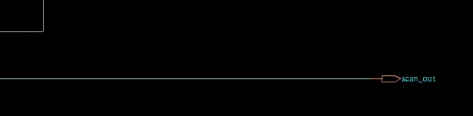

Slide 19
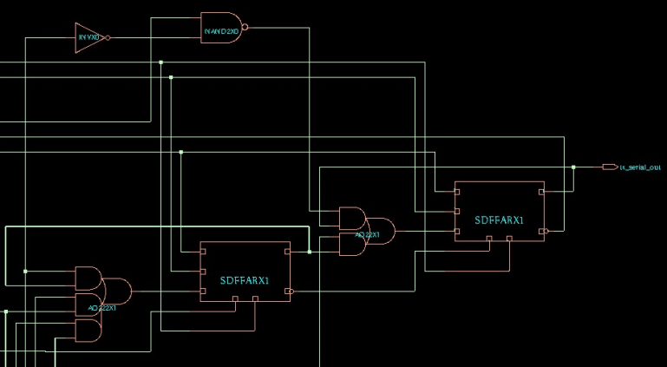

Slide 20
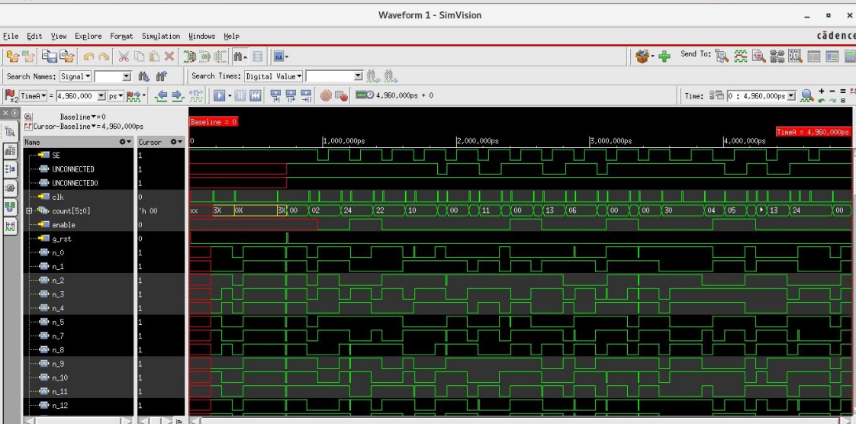
Xcelium waveform GUI screenshot

Slide 21
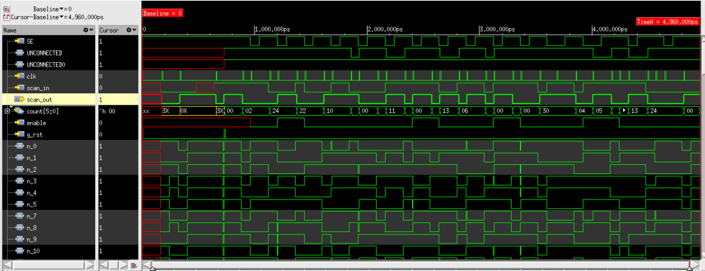

Slide 22
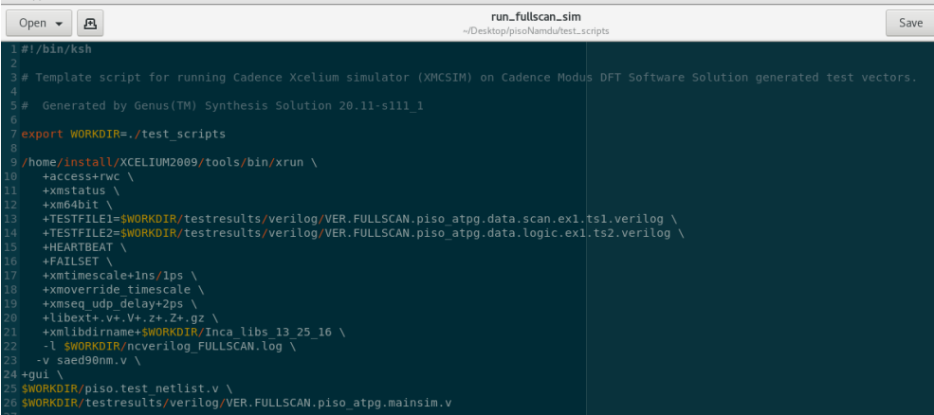
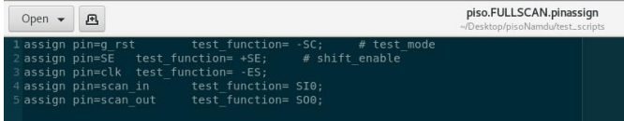

Slide 23

Thank you

